Slide 1

User Activity Analysis
Of an Online Forum
By Aleksandar Peshev

Slide 2
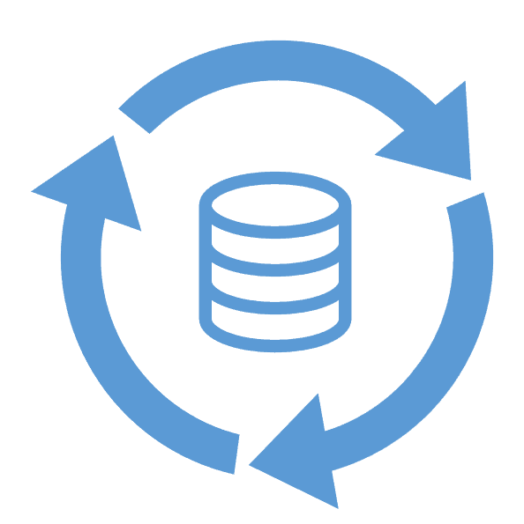


Data analysis lifecycle
Acquire
Transform
Maintain
Organize
Analyze
Communicate
Presenting findings

Slide 3
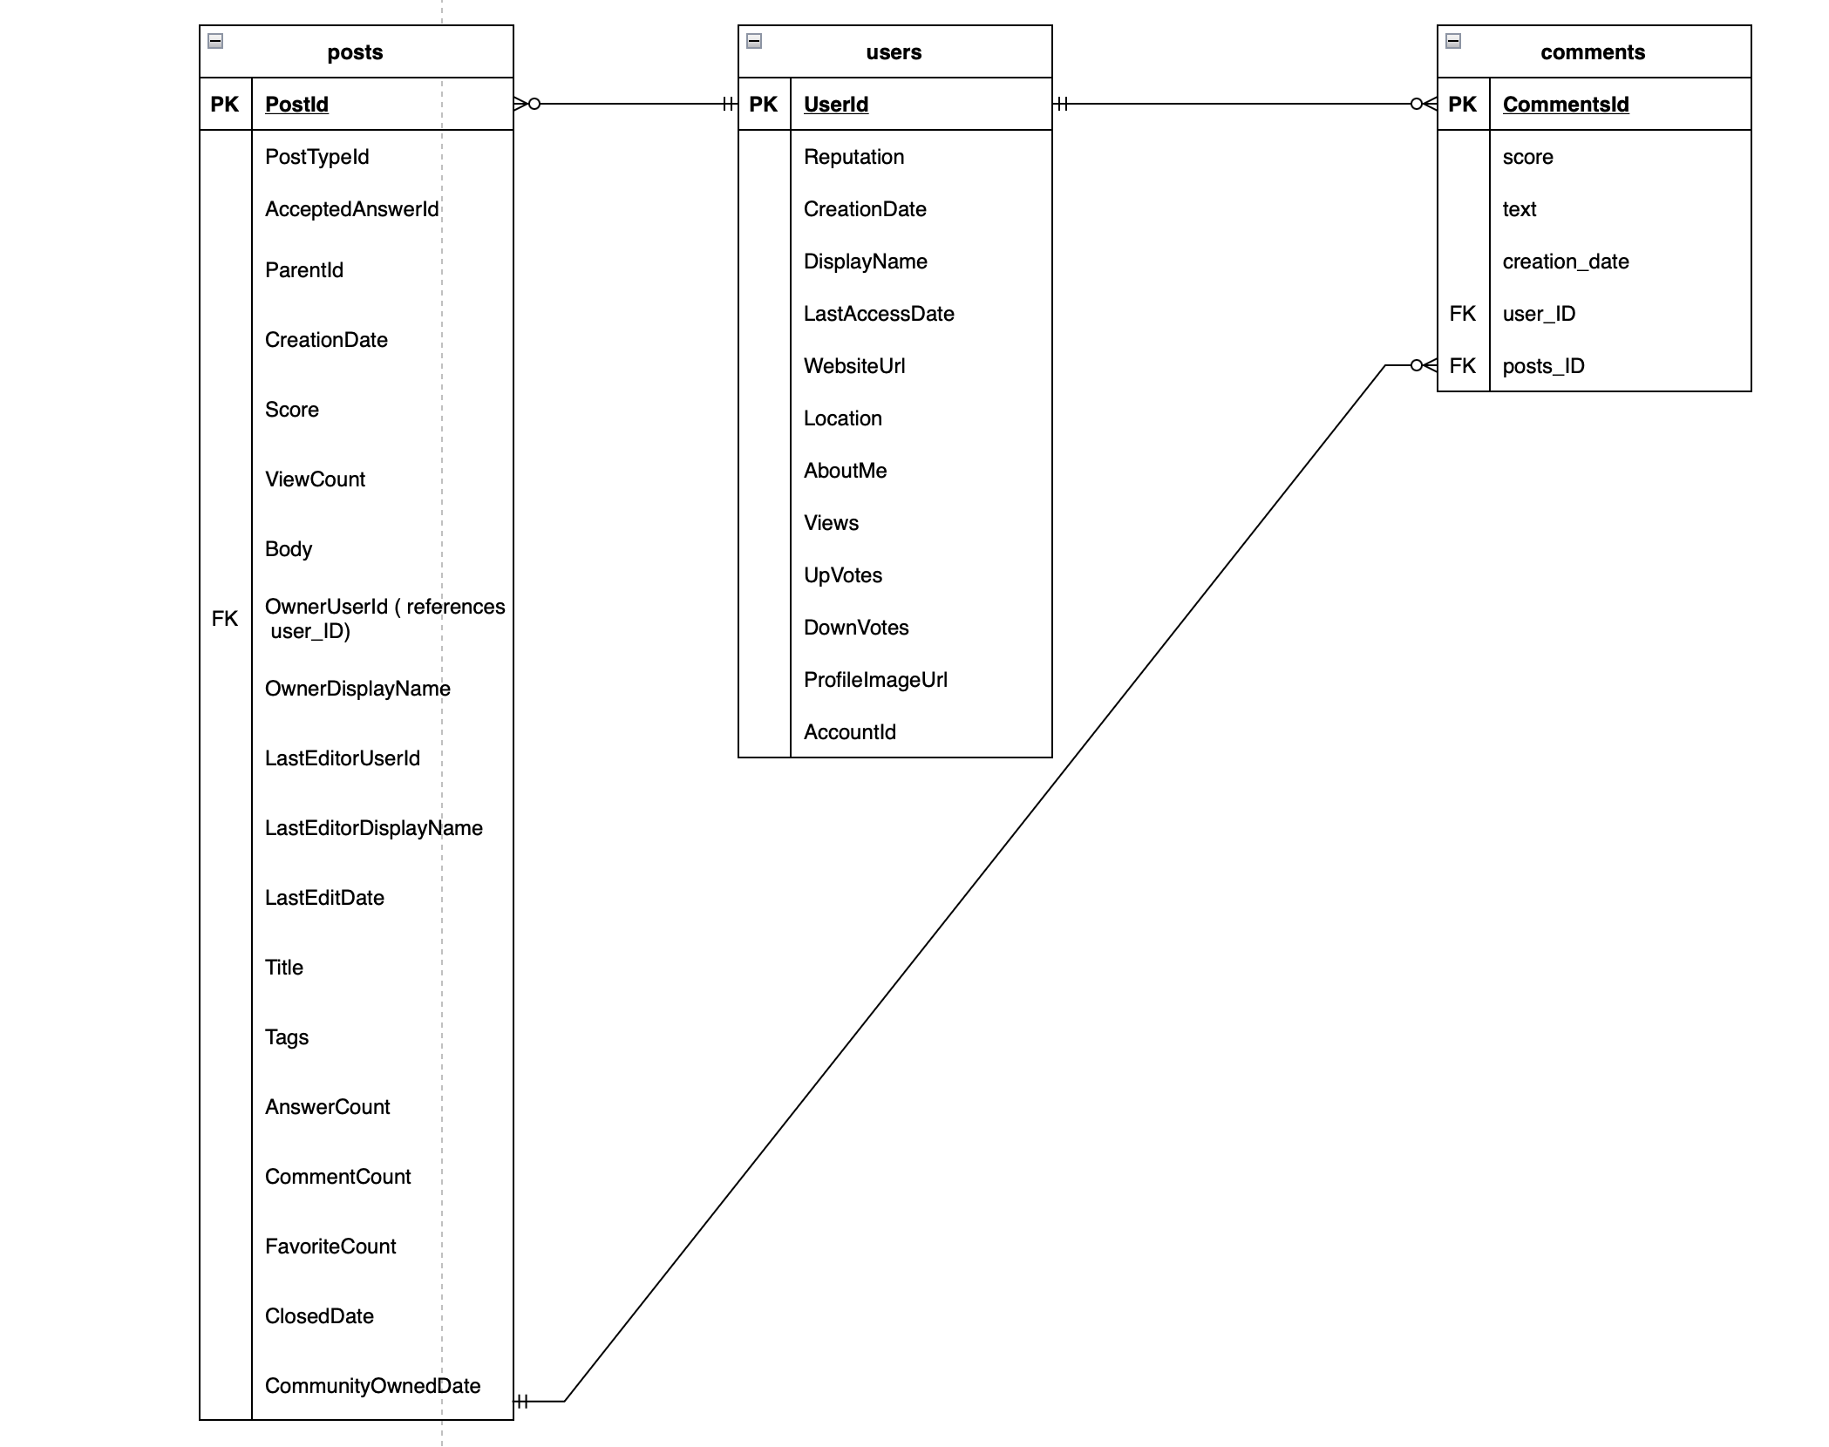
Data analysis lifecycle
What activities would you need to do before undertaking this project?
Review the CSV file and understand the data.
To create an Entity Relationship Diagram for a simple database.
Database normalization.
Data Accessing (Pre-Proccessing) and Creation.
Data Cleaning.
Storing the data.

Slide 4

Data analysis lifecycle
What would you need to do to allow this analysis to be repeated with updated data, and how would this solution be maintained?
Storing the data easily accessible format.
Updating - The SQL query will be kept up to date in the database with the most recent information.
- Maintaining the solution - It is important to make sure that the updated data complies with the current data structure.

Slide 5
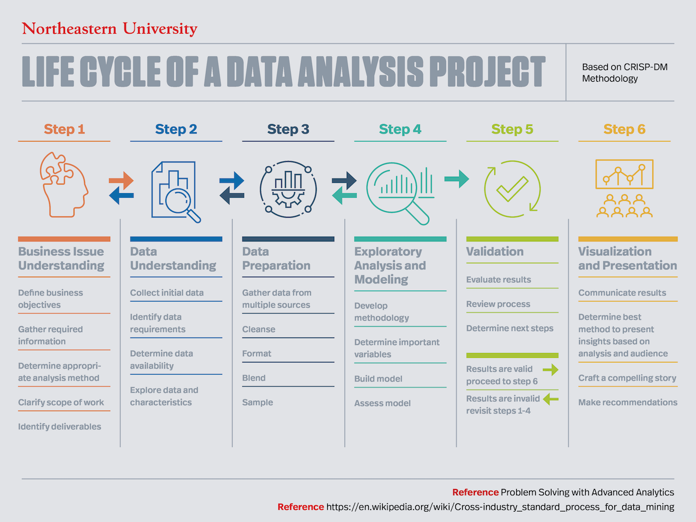
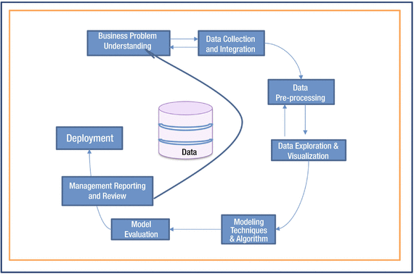
Data analysis lifecycle
How does this project fit into a broader data lifecycle?

Slide 6
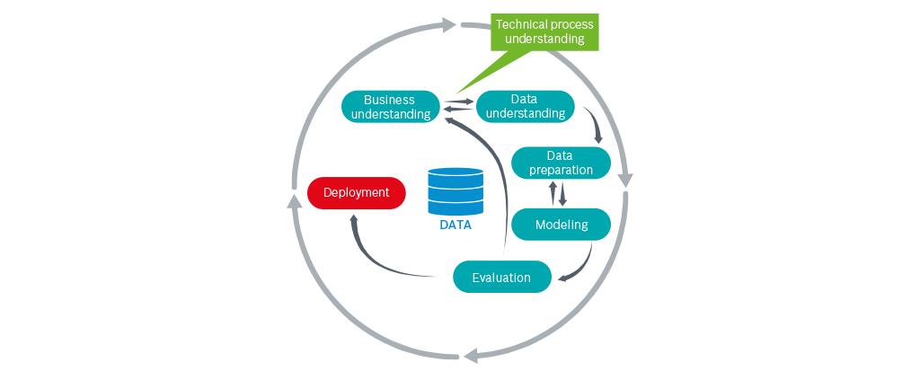
Data analysis lifecycle
How does this project fit into a broader data lifecycle?
Business issue and data
understanding
- Data Collection
- Data Storage
- Data Preparation
- Data Analysis
- Data Validation and Visualization
- Deployment and Presentation

Slide 7
Requirements
What aspects of the requirements were not 100% clear to you
Business Issue Understanding
Define business objectives
Gather required information
Determine appropriate analysis method
- Clarify scope of work
Identify deliverables
VS
Data Understanding
- Collect initial data
Identify data requirements
Determine data availability
- Explore data and characteristics

Slide 8

Requirements
Would it have been easier if you could talk directly to Oliver? If so, what sorts of questions would you want to ask him?
The excel workbook that was given to us was extremely comprehensive and made it easy for us to comprehend the necessary requirements. The level of detail in the workbook was such that it provided a clear and in-depth understanding of what was expected.

Slide 9
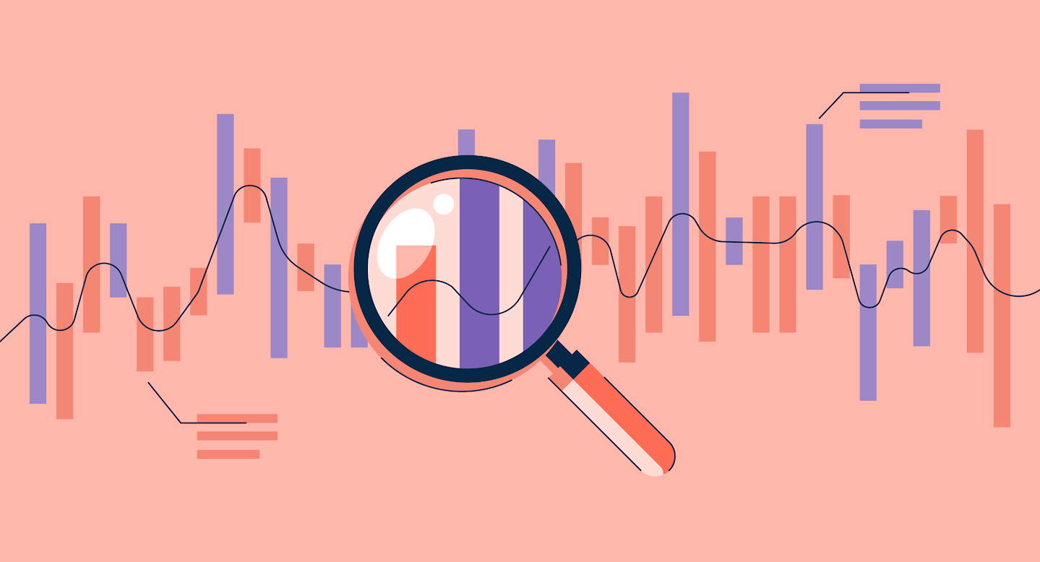

Requirements
How did you analyze the requirements?
- Read and understand the requirements document
- Explore the data (data exploration and cleansing techniques)
- Identify the type of SQL query required
- Test and refine the query

Slide 10



Data Analysis Tools
Were the tools you used appropriate for the job?
In summary, combining SQLite and Pandas in Jupyter Notebook is useful because it enables efficient and flexible data management, processing, and analysis, as well as easy collaboration and sharing of results through Jupyter notebook.

Slide 11

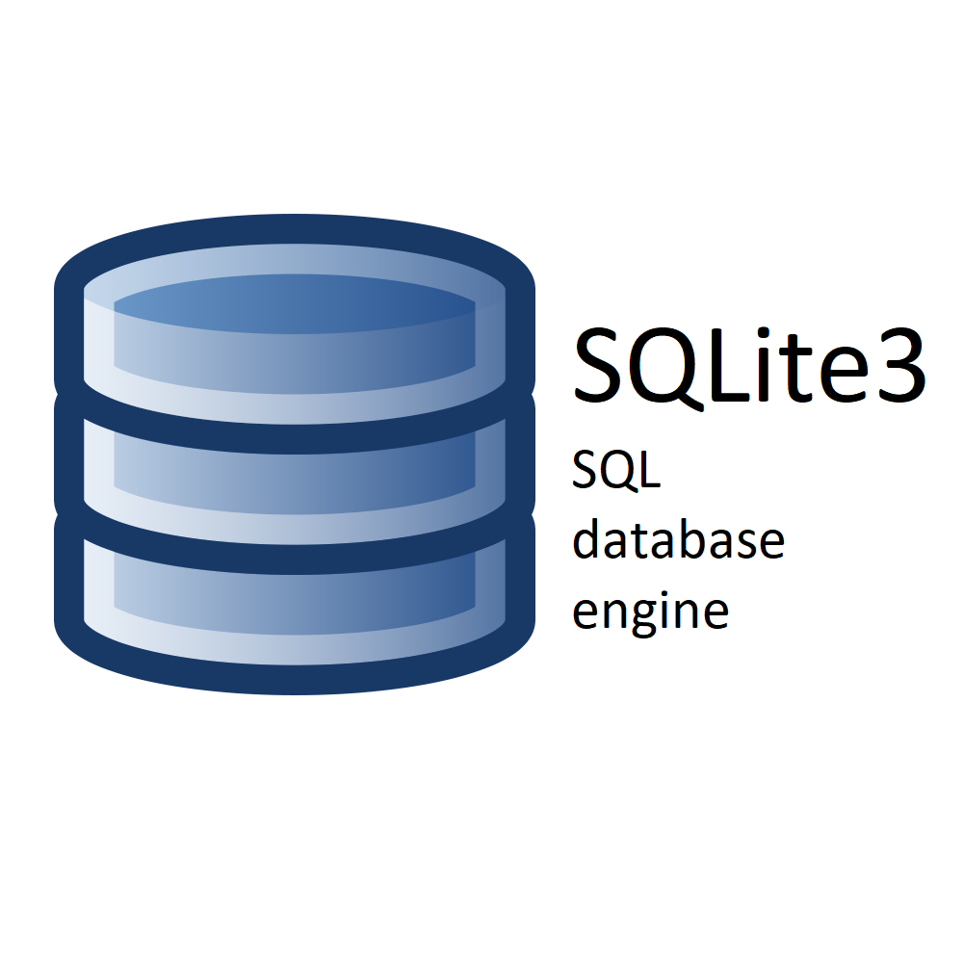

Data Analysis Tools
Why was SQLite used over PostgreSQL for this project?
SQLite is preferred over PostgreSQL for ad-hoc data analytics at ChatData due to security and privacy concerns. Access to the production PostgreSQL database is not granted for ad-hoc data analytics for protection of sensitive information. Instead, local copies of the data are used in SQLite, which is a lightweight relational database that uses SQL. SQLite is bundled with Python, making it easily accessible for data analysts. The use of SQLite also aligns with the principles of privacy by design and data privacy procedures at ChatData, ensuring that any data that can identify individuals is handled appropriately in compliance with government legislation such as GDPR.

Slide 12
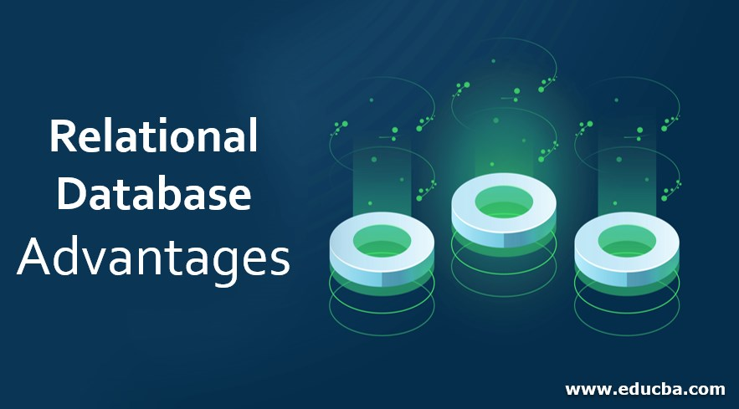
Data Analysis Tools
What are the benefits of adopting relational database technologies for an IT organization?
Scalability
Data Integrity
Efficient Data Retrieval
Flexibility
Security
Data duplication removal
Ease of Maintenance

Slide 13

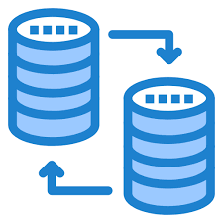

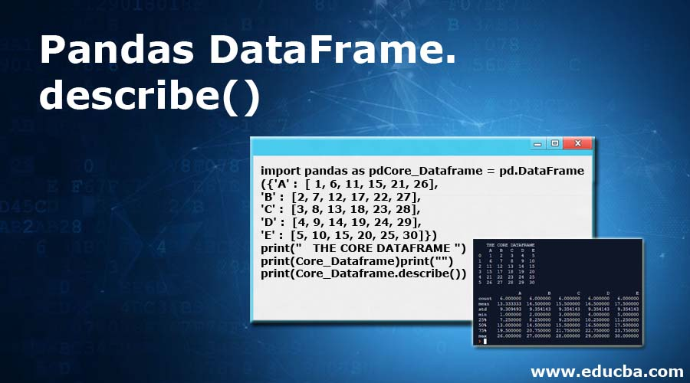

Data Quality
What did you think of the organization of the source data and how that mapped to the structure of your database? Was there a natural mapping from the CSV files to the database tables?
Yes, The CSV file has been arranged in such a way that it can be easily incorporated into the desired database format.

Slide 14

Data Quality
Was the data consistent? In other words, were there any issues with the data that prevented you from producing good quality results?
The data has underwent a thorough cleaning process and was subsequently inserted into three CSV files - one for posts, another for comments, and a third for users. This division of data helps to streamline the organization and management of the information, allowing for more efficient and effective utilization.

Slide 15
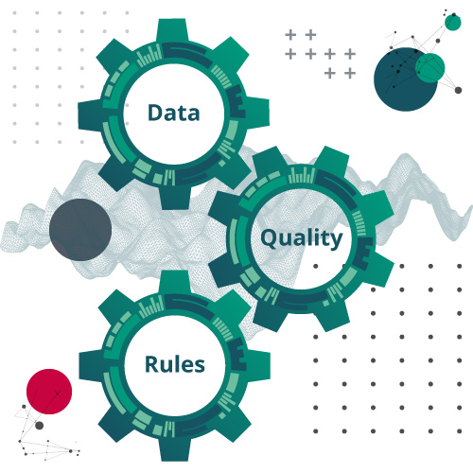
Data Quality
Did you find the definitions of the data were detailed enough to assist you in the tasks?
- No dictionary
- Intuitive datasets

Slide 16


Data Quality
What steps would you take to ensure that any concerns about data quality are dealt with appropriately? Who would you talk to about this?
Melanie
Data Quality
Clean the data

Slide 17

Security, Ethics & Legislation
Was the data sufficiently masked, or are there personal details present in the data?
Masking the user identity
Profile Image URL for personalized UX etc.

Slide 18
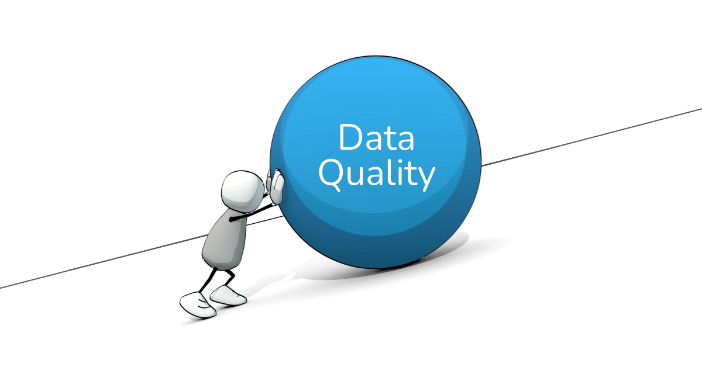
Security, Ethics & Legislation
Can you think of possible techniques (e.g. statistics) that could unmask the participants in this data?
- The short answer is no, but potentially there are several statistical techniques that could potentially unmask the participants in the data, even if their names and other personal information are masked or altered
The methods are:
Linking
Re-identification
Data aggregation
Access to users’ real names etc.

Slide 19
Security, Ethics & Legislation
Are there any ethical considerations with our intended use of this data?
Privacy
Consent
Transparency
Accuracy
Data security

Slide 20


Security, Ethics & Legislation
Is the use of this data covered by any legislation, and if so, what is that legislation?

Slide 21
References
https://matthewrenze.com/articles/the-data-life-cycle/
http://clipart-library.com/an-arrow.html
https://www.seekpng.com/ipng/u2e6a9e6o0i1i1i1_life-cycle-icon/
https://www.presentermedia.com/powerpoint-clipart/stickman-question-mark-thinking-pc-pid-1680
https://www.theschoolrun.com/what-question-mark
https://blog.rosettastone.com/whats-up-with-the-upside-down-question-mark/
https://www.g2.com/articles/data-analysis-process
https://www.c-sharpcorner.com/UploadFile/55275a/windows-phone-8-1-sqlite-how-to-store-data-in-database/
https://sailajakarra.medium.com/python-and-sqlite3-7e7e19d62254
https://www.vecteezy.com/vector-art/7166964-versus-or-vs-logo-design-template
https://www.murici.al.leg.br/imagens/csv.png/image_view_fullscreen

Slide 22



